Slide 1
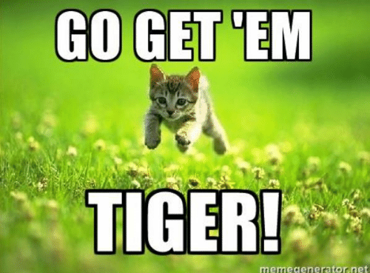
CISC 372 Text Analytic IIII EM & LDA
https://giphy.com/gifs/kid-costume-transformer-R9zXHWAHyTjnq

Slide 2
Last lectures
Expectation Maximization
Mode-based clustering
Iterative approach for optimization
Domain knowledge integration

Slide 3
Today
EM
An example
LDA & Gibb Sampling

Slide 4

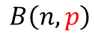
Coin Flipping
H T H H H H H H T H H T H
H H H H H T H H H T H T H
H H H H H H H H H H T H H
H T H H T H H H H H H T H
Binominal Distribution:
$$B\left(n,p\right)$$
https://giphy.com/gifs/Friends-episode-12-friends-tv-the-one-with-embryos-Y4cMaANkENnOxDEPe6

Slide 5
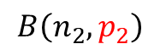
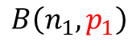
Coin Flipping using Two coins
H T H H H H H H T H H T H
T T T T H H T T T T H T H
H H H H H T H H H T H T H
T T T T T T T H T H T H T
H T T T T T T T T H T H T
T T T T T T H T T T T T H
H H H H H H H H H H T H H
T H T H T T T T T T T T H
H T H H T H H H H H H T H
Flipping coins
there are two coins
And each of them has a different chance of observing head/tail
Binominal Distribution:
$$B\left(n_{1},p_{1}\right)$$
$$B\left(n_{2},p_{2}\right)$$
https://giphy.com/gifs/Friends-episode-12-friends-tv-the-one-with-embryos-Y4cMaANkENnOxDEPe6

Slide 6
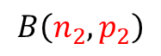
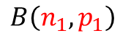
What if we don't know which coin was used in which flip??
H T H H H H H H T H H T H
T T T T H H T T T T H T H
H H H H H T H H H T H T H
T T T T T T T H T H T H T
H T T T T T T T T H T H T
T T T T T T H T T T T T H
H H H H H H H H H H T H H
T H T H T T T T T T T T H
H T H H T H H H H H H T H
Flipping coins
there are two coins
And each of them has a different chance of observing head/tail
Binominal Distribution:
$$B\left(n_{1},p_{1}\right)$$
$$B\left(n_{2},p_{2}\right)$$
https://giphy.com/gifs/Friends-episode-12-friends-tv-the-one-with-embryos-Y4cMaANkENnOxDEPe6

Slide 7
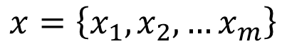
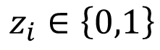
What if we don't know which coin was used in which flip??
H T H H H H H H T H H T H
T T T T H H T T T T H T H
H H H H H T H H H T H T H
T T T T T T T H T H T H T
H T T T T T T T T H T H T
T T T T T T H T T T T T H
H H H H H H H H H H T H H
T H T H T T T T T T T T H
H T H H T H H H H H H T H
$$x=\left\{x_{1},x_{2},…x_{m}\right\}$$
$$z_{i}∈\left\{0,1\right\}$$
Flipping coins
there are two coins
And each of them has a different chance of observing head/tail
Binominal Distribution:
$$B\left(n_{1},p_{1}\right)$$
$$B\left(n_{2},p_{2}\right)$$
https://giphy.com/gifs/Friends-episode-12-friends-tv-the-one-with-embryos-Y4cMaANkENnOxDEPe6

Slide 8
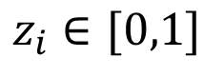
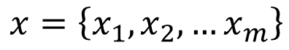
What if we don't know which coin was used in which flip??
$$x=\left\{x_{1},x_{2},…x_{m}\right\}$$
$$z_{i}∈[0,1]$$
H T H H H H H H T H H T H
T T T T H H T T T T H T H
H H H H H T H H H T H T H
T T T T T T T H T H T H T
H T T T T T T T T H T H T
T T T T T T H T T T T T H
H H H H H H H H H H T H H
T H T H T T T T T T T T H
H T H H T H H H H H H T H
EM Algorithm:
Randomly assign each flip to a coin (random z)
Estimate the parameter for that coin w.r.t. n & p
Update the flip assignment Z based on the updated parameters for these two coins
Go back to 2, until converge
Flipping coins
there are two coins
And each of them has a different chance of observing head/tail
Binominal Distribution:
$$B\left(n_{1},p_{1}\right)$$
$$B\left(n_{2},p_{2}\right)$$
https://giphy.com/gifs/Friends-episode-12-friends-tv-the-one-with-embryos-Y4cMaANkENnOxDEPe6

Slide 9

LDA – Document Generation (no labels)
How would you generate (write) a document??
https://www.google.com/url?sa=i&url=https%3A%2F%2Fgiphy.com%2Fexplore%2Fwriting&psig=AOvVaw0o9_6cyMD_wS5Z7ulvHsPF&ust=1583516912871000&source=images&cd=vfe&ved=0CAIQjRxqFwoTCNCsiKzyg-gCFQAAAAAdAAAAABAY

Slide 10
LDA – Document Generation
What it is about??
Pick a set (mixture of topics)
Start writing word-by-word
Each word is generated one-by-one
Which one to use?
Depends on the what is the topic to be covered
https://www.google.com/url?sa=i&url=https%3A%2F%2Fgiphy.com%2Fexplore%2Fwriting&psig=AOvVaw0o9_6cyMD_wS5Z7ulvHsPF&ust=1583516912871000&source=images&cd=vfe&ved=0CAIQjRxqFwoTCNCsiKzyg-gCFQAAAAAdAAAAABAY

Slide 11
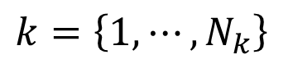

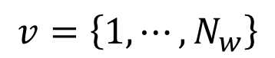
LDA – Document Generation
i denotes the index of a document
v denotes the index of a word
k denotes the index of a topic
$$ⅈ=\left\{1,⋯,N_{D}\right\}$$
$$v=\left\{1,⋯,N_{w}\right\}$$
$k=\left\{1,⋯,N_{k}\right\}$

Slide 12
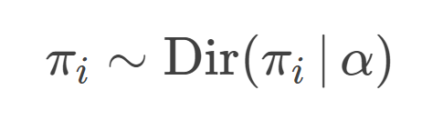
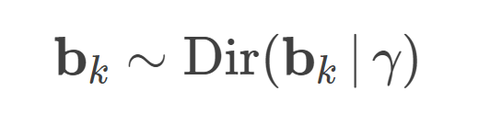
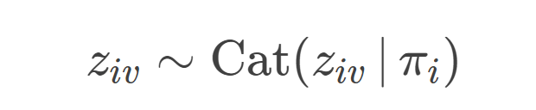
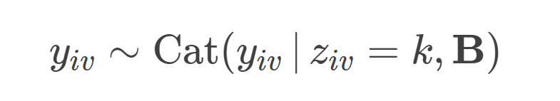

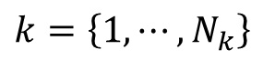
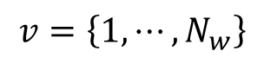
LDA – Document Generation
To generate a document, we need a mixture of topics:
How about topic? Topic itself is a mixture of words.
Given a document, to generate a word, we need to know what topics to be used
Then given the topic for this word under this document, we can generate the actual word (observation)
$$ⅈ=\left\{1,⋯,N_{D}\right\}$$
$k=\left\{1,⋯,N_{k}\right\}$
$$v=\left\{1,⋯,N_{w}\right\}$$

Slide 13
LDA – Document Generation
Learning – Gibbs Sampler
Bayesian Inference
Iterative approach
Update the parameters/assignment for each variable at a time
A variants of generalized EM algorithm
Hyperparameter: number of topics
Nice implementation:
Gensim
https://radimrehurek.com/gensim/models/ldamodel.html
Example:
https://radimrehurek.com/gensim/auto_examples/tutorials/run_lda.html

Slide 14
LDA – After training
A document is a distribution over topics:
A topic is a distribution over words
$$ⅈ=\left\{1,⋯,N_{D}\right\}$$
$k=\left\{1,⋯,N_{k}\right\}$

Slide 15
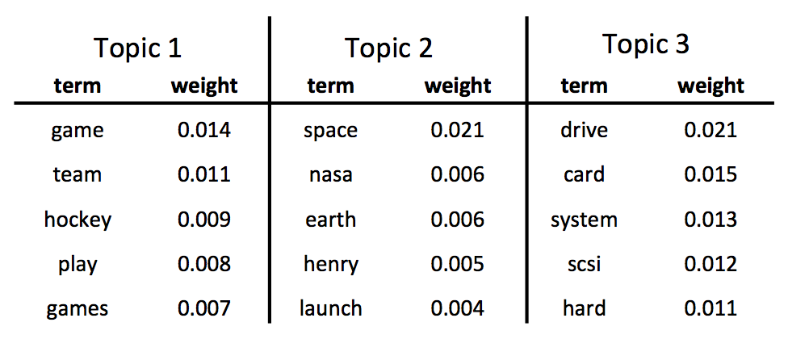
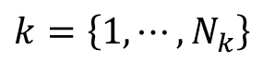
LDA – Document Generation
How about topic? Topic itself is a mixture of words.
$k=\left\{1,⋯,N_{k}\right\}$
https://databricks.com/blog/2015/03/25/topic-modeling-with-lda-mllib-meets-graphx.html

